Slide 1
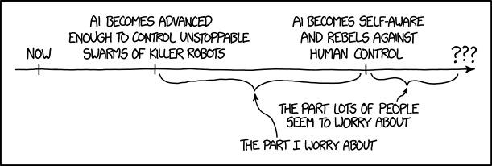
AI for the rest of us

Slide 2
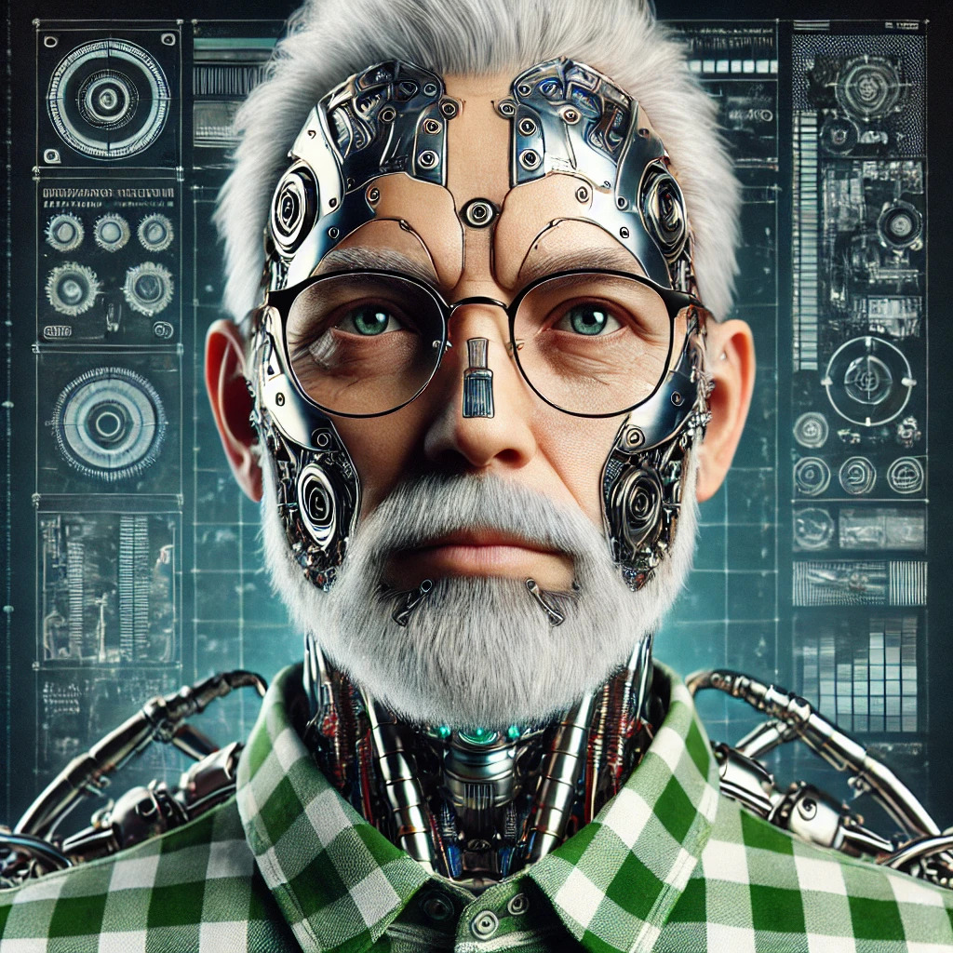
About yours truly

Slide 3
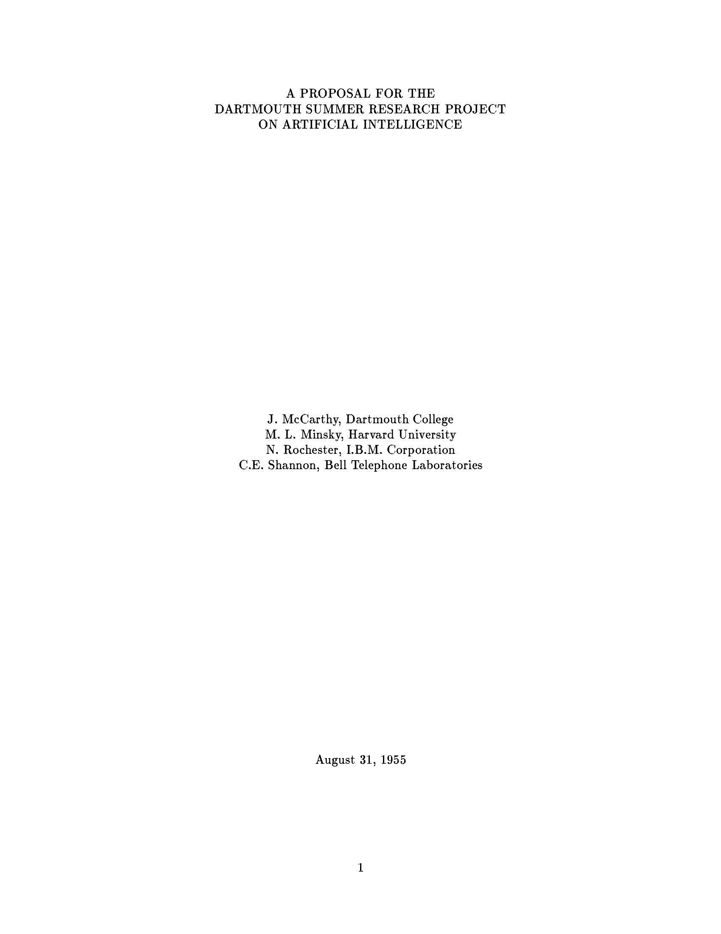
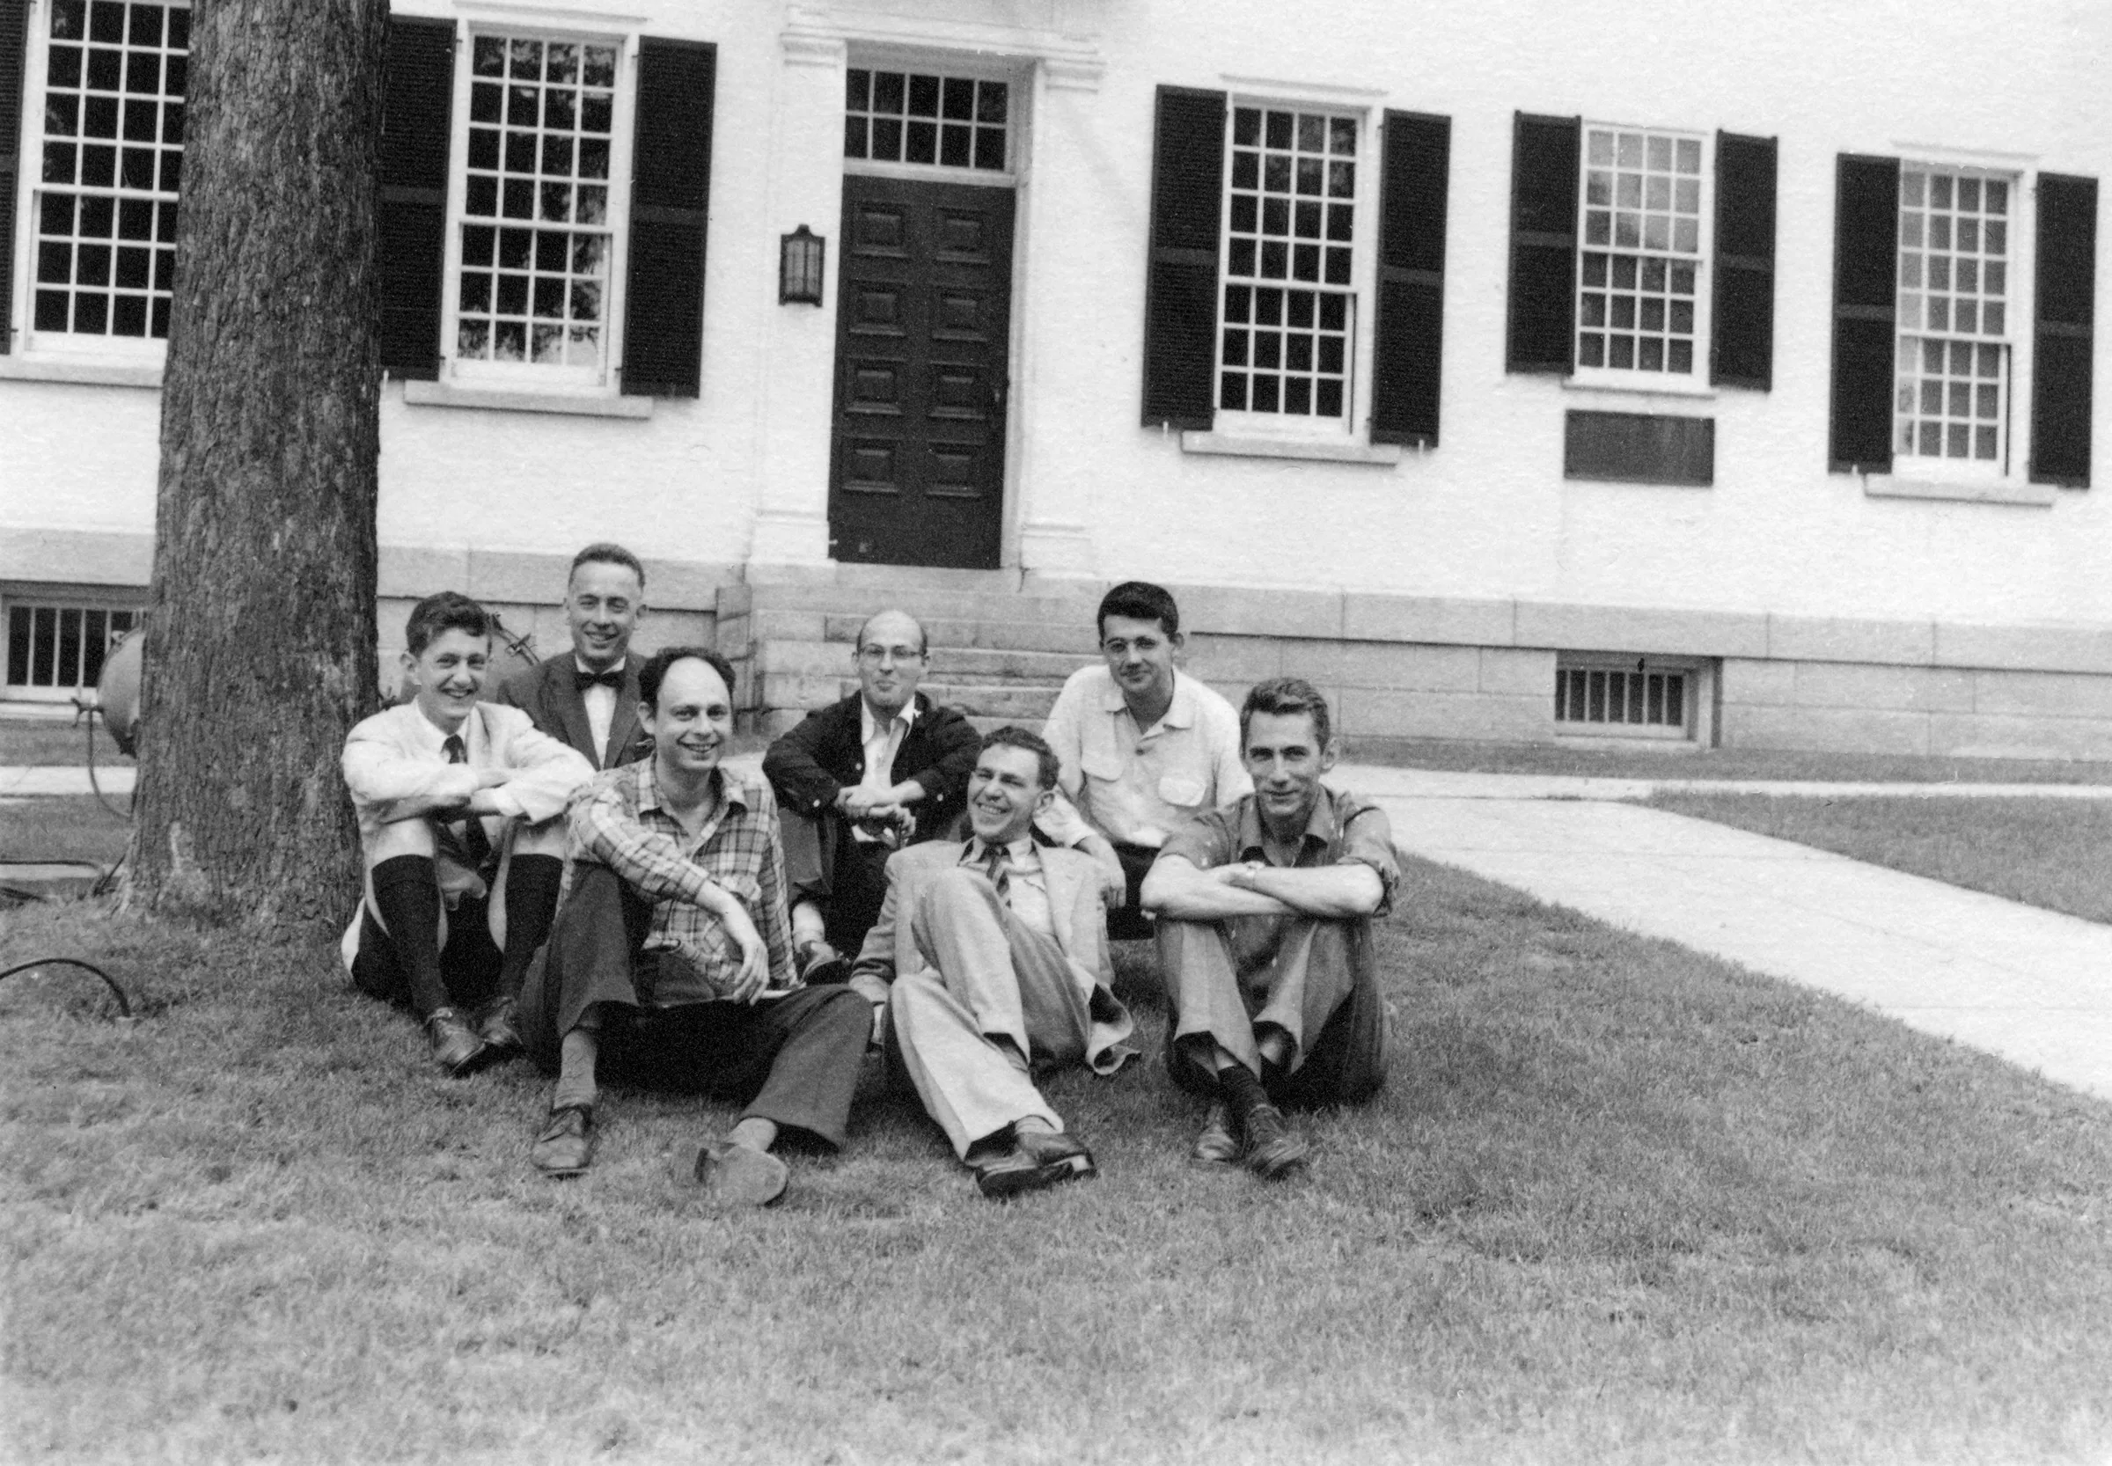
Artificial Intelligence – the 70-year-old overnight sensation

Slide 4
ChatGPT – a terrible name for a terribly successful product
ChatGPT = “Chat” + “Generative” “Pretrained” Transformer”
Generative: Creates original content (text, images, code) rather than just copying existing data.
Pre-trained: The model undergoes extensive initial training on vast amounts of data to learn patterns before being fine-tuned for specific tasks.
Transformer: A mechanism to analyze relationships between all words in a sentence simultaneously and use those words in the appropriate context.

Slide 5
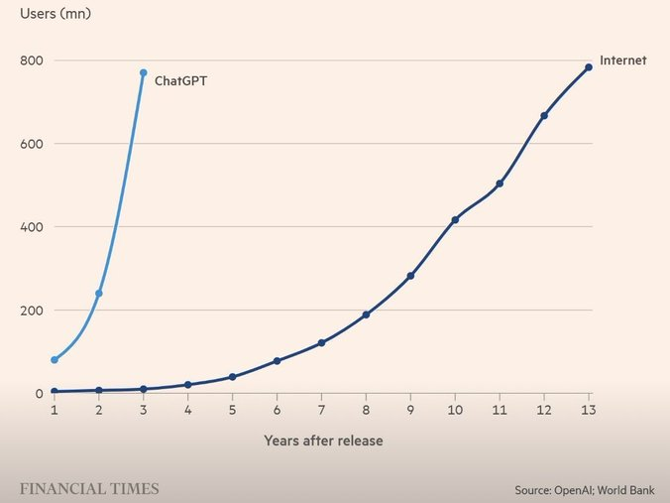
The fastest-growing product, like, ever

Slide 6
Major AI services
ChatGPT – the one that started it all*
Claude – the stellar programming service
Gemini – Google’s AI services
Copilot – Microsoft, integrated into Windows and Office
Meta – Parent company of Facebook and Instagram with its own suite of AI tools
Adobe – Integrated with Acrobat, Photoshop, and others
* There is no first anything

Slide 7
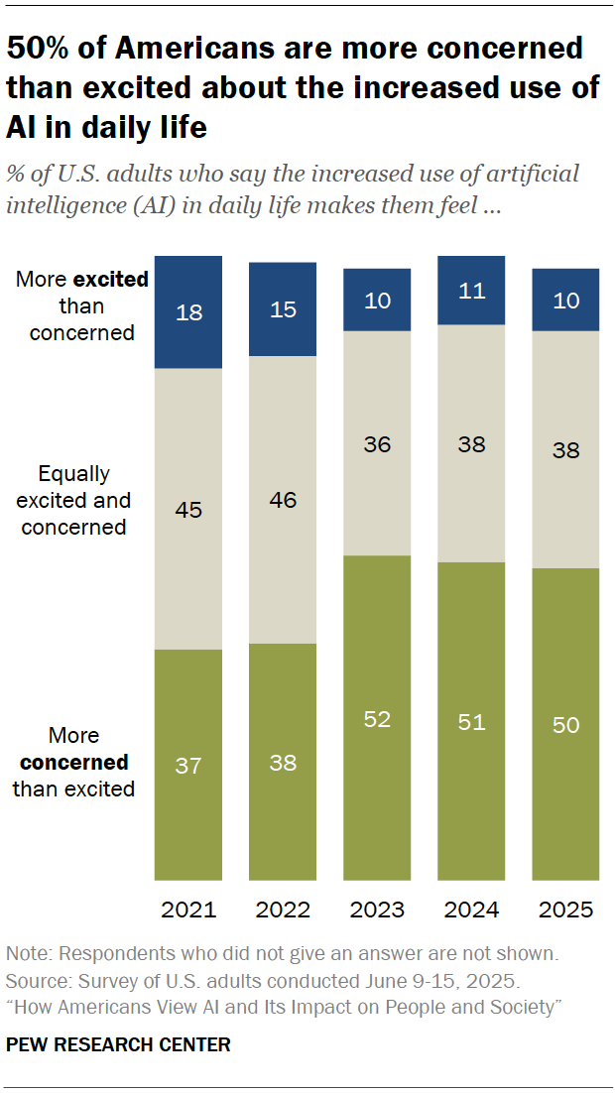
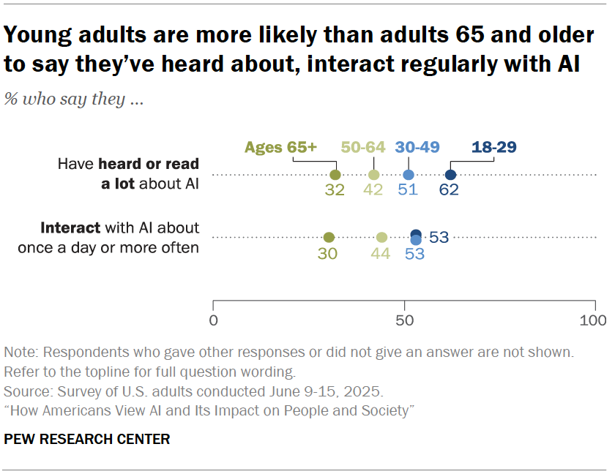
Key findings about how Americans view artificial intelligence
Pew Research Center, 12-Mar-2026

Slide 8
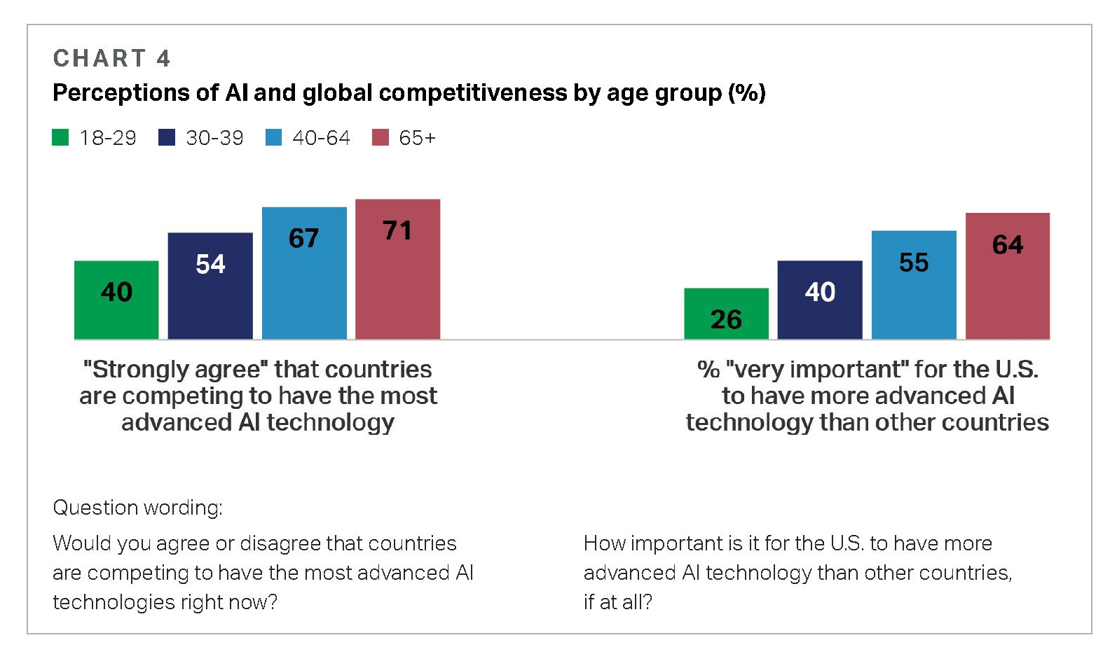
Gallup-SCSP American Perspectives on AI

Slide 9
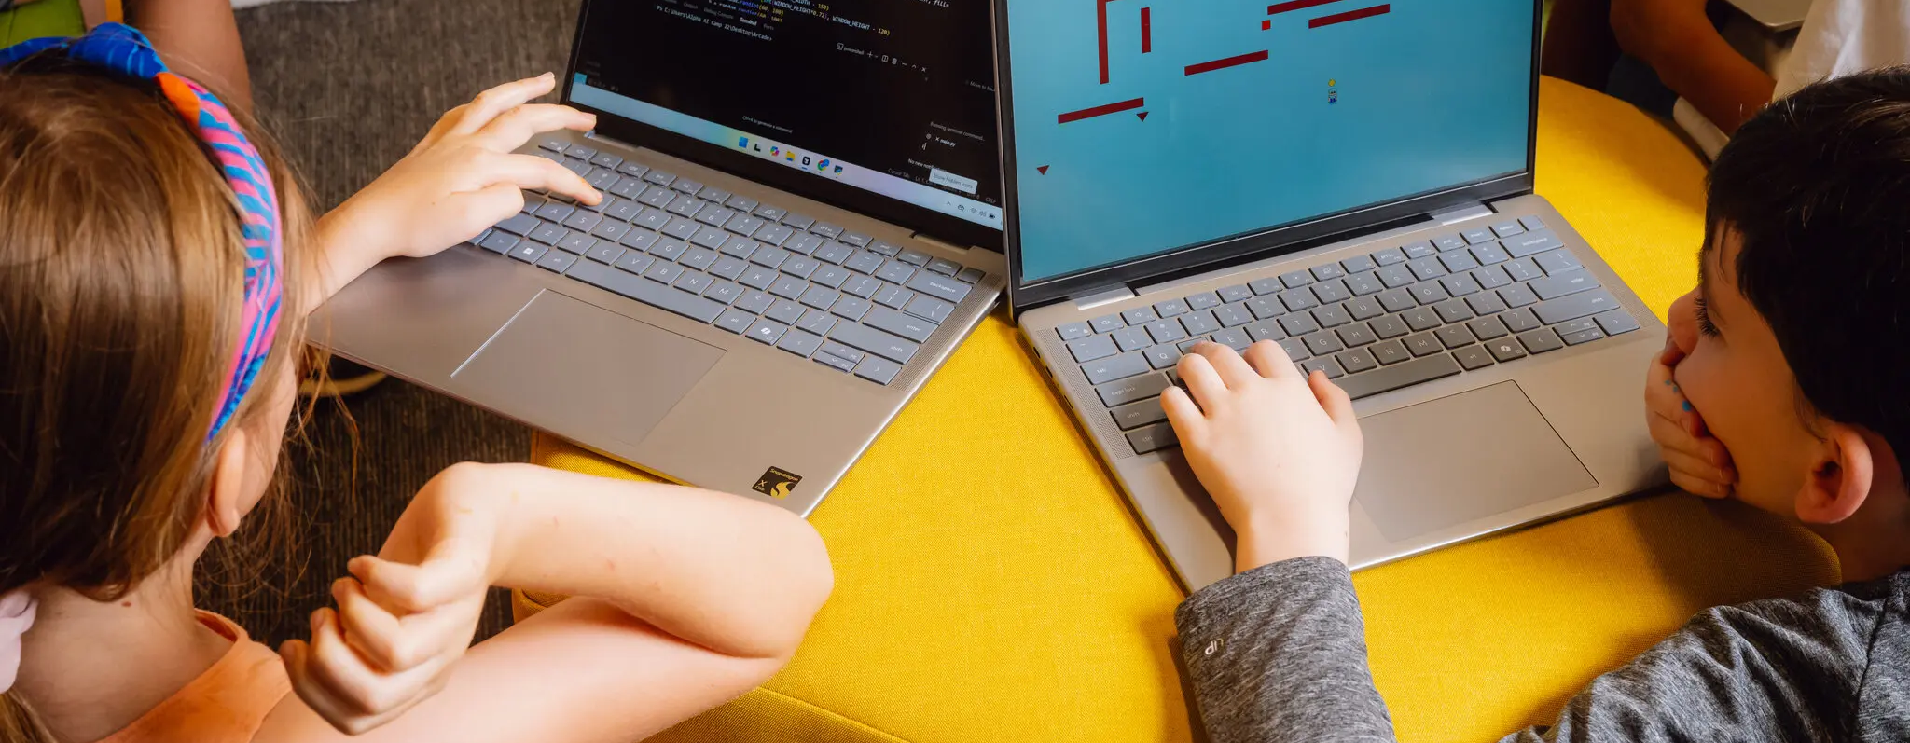
A.I.-Driven Education: Founded in Texas and Coming to a School Near You
No more teachers: AI school pitched for Boston

Slide 10

Learn AI with Google & MA AI Hub

Slide 11
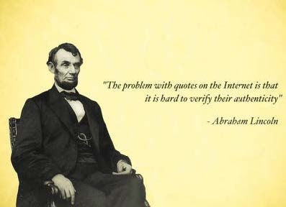
Whom do you trust?

Slide 12
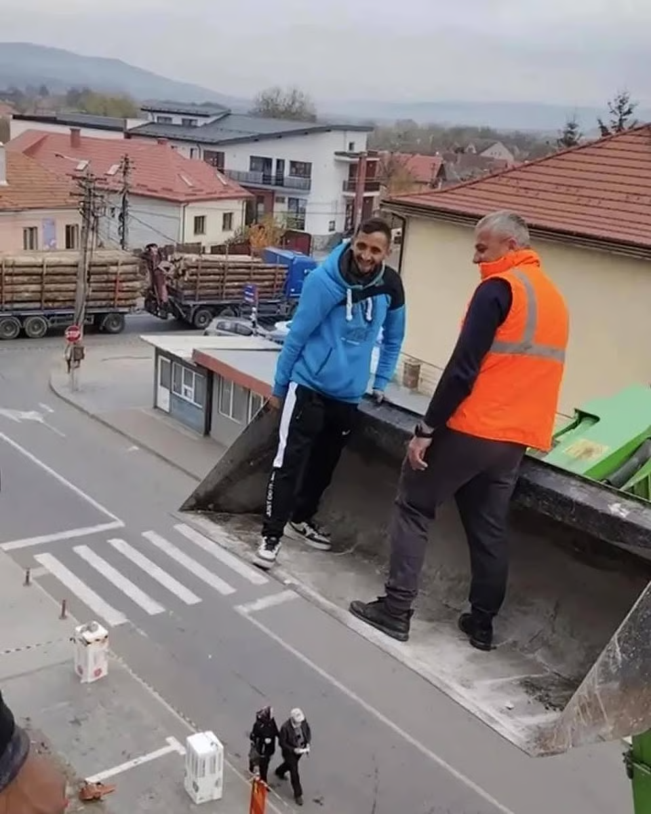
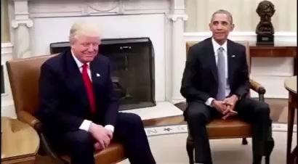
How do we know what is real?

